Slide 1
ADA Accessible Documents
Joel Selby, Special Projects Manager Muskegon Area Intermediate School District

Slide 2
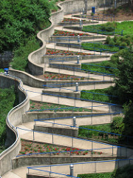
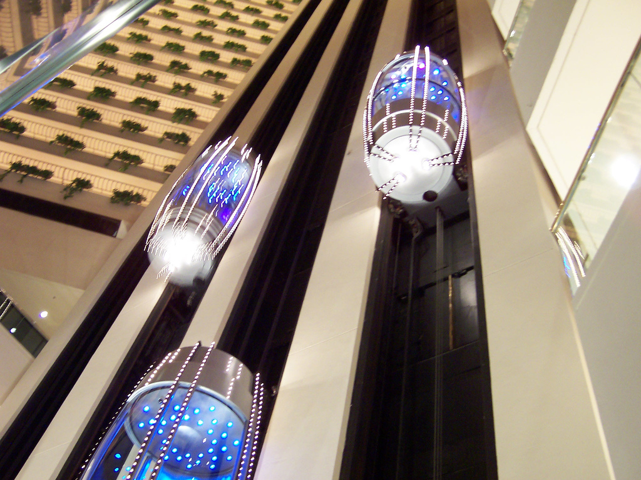
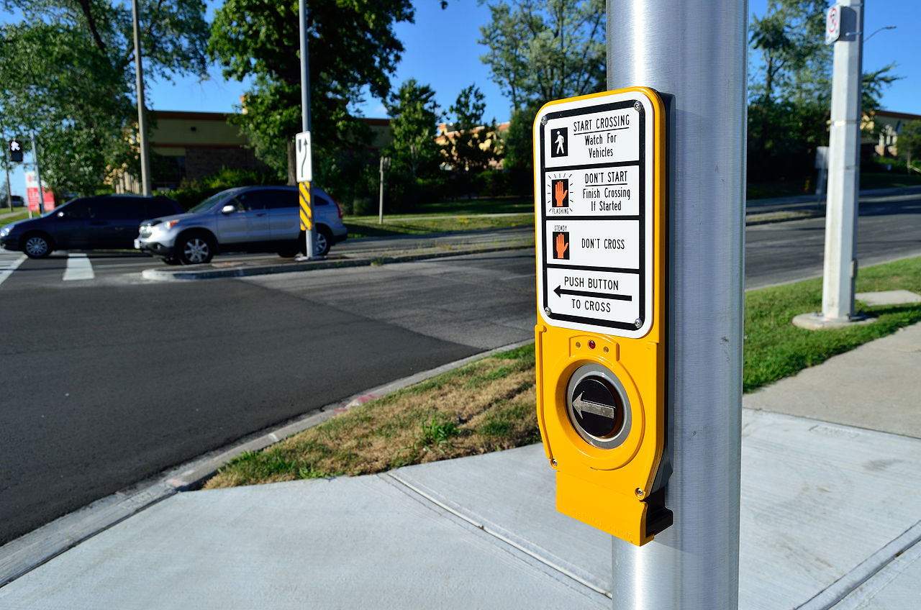
New Aspects of ADA Compliance
Yesterday’s ramps, elevators, and talking crosswalks…
Are today’s accessible websites and documents

Slide 3
Challenges for Disabled Individuals
Visual Impairments
Screen Readers
Color Blindness
Hearing Impairments
Closed Captioning
Audio Transcripts
Fine Motor Impairments
Alternate Input Devices
Keyboard Navigation
Cognitive Impairments
Simple Language
Common Sense Navigation

Slide 4
Standards
Web Content Accessibility Guidelines (WCAG) 2.0
Levels of Conformance: A, AA, AAA
AAA is highest level
Section 508 Standards for Electronic and Information Technology
US Access Board

Slide 5
Principles of Accessible Design

Slide 6
Accessible Design Principles
Provide appropriate alternative text
Make sure that content is well structured and clearly written
Provide headers for data tables
Ensure users can complete and submit all forms
Ensure links make sense out of context
Caption and/or provide transcripts for media
Do not rely on color alone to convey meaning
Design to standards

Slide 7
Appropriate Alternative Text
Use fewest number of words necessary
Avoid words like “picture of” and “image of”
Alt text should present the content and function of an image, not necessarily a description of an image
Context is crucial
If you have already described the content of an image with nearby text, the image should probably have empty alt text.
If an image, chart, or graph requires a lengthy description, make sure that information is available in one of the following ways (in preferred order)
Provide the long description in the content of the document itself
Provide a link to a long description via a normal text link
Make the image a link to a longer description

Slide 8
Alternative Text – Example 1
Because of his role as the Commander in Chief of American forces in the Revolutionary War, and, later, the first President of the United States, George Washington is often called the "Father of his Country".
“Image of George Washington”
“George Washington, the first president of the United States”
The image does not need alt text.
“George Washington”
Notes:
ANSWER: Option D

Slide 9
Alternative Text – Example 1 Answer
Because of his role as the Commander in Chief of American forces in the Revolutionary War, and, later, the first President of the United States, George Washington is often called the "Father of his Country".
“Image of George Washington”
“George Washington, the first president of the United States”
The image does not need alt text.
“George Washington”
Option D is the most concise. Saying “image of” is unnecessary, repeating that George Washington was the first president is repetitive, and not having alternative text would produce an error and leave the reader wondering who the subject of the paragraph is until 2/3 through the text.
Notes:
ANSWER: Option D

Slide 10
Alternative Text – Example 2
George Washington
Because of his role as the Commander in Chief of American forces in the Revolutionary War, and, later, the first President of the United States, George Washington is often called the "Father of his Country".
“George Washington”
The image should be marked as decorative (an artifact).
“Image”
The image does not need alt text.
Notes:
ANSWER: Option B

Slide 11
Alternative Text – Example 2 Answer
George Washington
Because of his role as the Commander in Chief of American forces in the Revolutionary War, and, later, the first President of the United States, George Washington is often called the "Father of his Country".
“George Washington”
The image should be marked as decorative (an artifact).
“Image”
The image does not need alt text.
If the document will be converted to PDF, Option B is the answer. (Note: There is no way in Microsoft Office to mark an object as decorative.) Option A would be repetitive. Option C is unhelpful. Option D would produce an error.
Notes:
ANSWER: Option B

Slide 12
Alternative Text – Example 3
Image is linked to a Wikipedia article.
George Washington
The image should be marked as decorative (no alt text).
“Wikipedia entry for George Washington”
“Read More”
“George Washington”
Change the link to wrap around the text as well.
Notes:
ANSWER: Option D; However, it would be more appropriate if the link wrapped around both the image and text. The alt text on the image could then be left empty.

Slide 13
Alternative Text – Example 3 Answer
Image is linked to a Wikipedia article.
George Washington
The image should be marked as decorative (no alt text).
“Wikipedia entry for George Washington”
“Read More”
“George Washington”
Change the link to wrap around the text as well.
Option E would be the preferred method here. Option A would leave the link with no text (which might lead the screen reader to read the URL of the image). Options B & D would both be repetitive if a screen reader was reading from top to bottom. Option C is unhelpful and would be no better than a “click here” link.

Slide 14
Alternative Text – Example 4
In this painting, the artist Emanuel Leutze used light, color, form, perspective, proportion, and motion to create the composition.
“George Washington”
“Painting of George Washington”
“Painting of George Washington crossing the Delaware River”
“A class painting demonstrating the use of light and color to create composition.”
“Painting of George Washington crossing the Delaware River. Swirling waves surround the boat where the majestic George Washington looks forward out of the storm and into the rays of light across the river as he leads his wary troops to battle.
Notes:
ANSWER: Option C; however, the answer could depend on the context and intended content of the image.

Slide 15
Alternative Text – Example 4 Answer
Depending on the purpose and context here, Options C, D, or E may be appropriate. Option A is not descriptive enough. Option B is not descriptive and no better than “image of…”
In this painting, the artist Emanuel Leutze used light, color, form, perspective, proportion, and motion to create the composition.
“George Washington”
“Painting of George Washington”
“Painting of George Washington crossing the Delaware River”
“A class painting demonstrating the use of light and color to create composition.”
“Painting of George Washington crossing the Delaware River. Swirling waves surround the boat where the majestic George Washington looks forward out of the storm and into the rays of light across the river as he leads his wary troops to battle.
Notes:
ANSWER: Option C; however, the answer could depend on the context and intended content of the image.

Slide 16
Adding Alternative Text
Always add a Description
If the description is long, provide a Title

Slide 17
Well-Structured Content
Using Styles & Headings throughout Documents
Aligning and spacing content through the use of
Line spacing
Paragraph spacing
Margins
Tabs and Tab Stops

Slide 18
Headings
Heading Levels 1-6
Don’t Skip Levels
Example:
H1 – Document Title
H2 – Major Heading
H2 – Major Heading
H3 – Minor Heading
H2 – Major Heading
H3 – Minor Heading
H4 – Even More Minor Heading

Slide 19
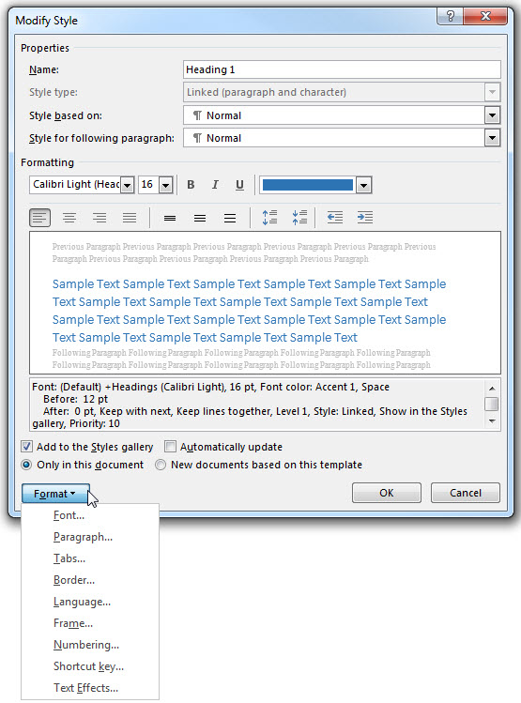
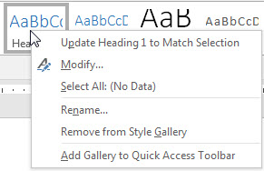
Styles
Use Styles to format text and add structure/hierarchy to documents

Slide 20
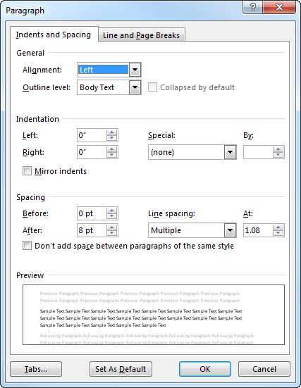
Spacing
Set spacing before and after paragraphs and use line spacing instead of using extra Returns (Enters)
Use a “soft” return (Shift+Enter) to force text to another line without creating a new paragraph
Don’t use multiple “returns” when you can adjust the line and paragraph spacing

Slide 21
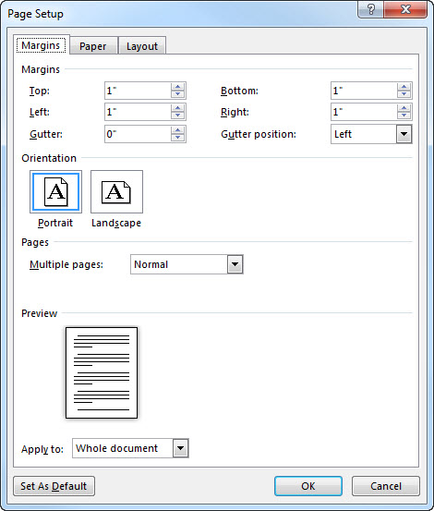
Margins
Set margins for the whole document

Slide 22
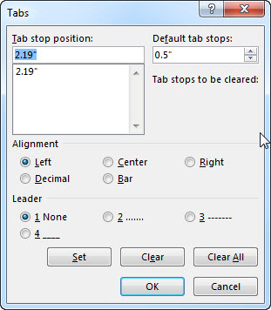
Tabs
Use Tab Stops instead of multiple Tabs or Spaces

Slide 23
Headers for Data Tables
Use and identify column and row headers for data tables
Avoid using tables solely for layout purposes
Avoid merging cells
Place table titles outside the table structure
District | Male Students | Female Students | Total Enrollment
Fruitport | 25 | 27 | 52
Mona Shores | 31 | 29 | 60
Montague | 21 | 22 | 43
Muskegon | 35 | 38 | 73
Muskegon Heights | 18 | 17 | 35
North Muskegon | 17 | 19 | 36

Slide 24
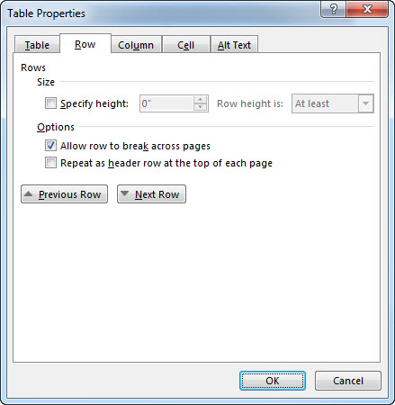
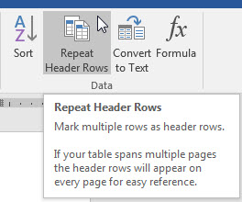
Setting Table Header Columns
Under Table Properties, check “Repeat as header row at the top of each page”

Slide 25
Links Make Sense Out of Context
Avoid
Phrases such as “Click Here” or “Here”
Phrases such as “More”, “More Information”, and “Continue”
Links that only describe a file type, such as “HTML”, “PDF”, and “Word” repeated over and over.
URLs as link text
This may sometimes be appropriate, if the actual URL text is important, but should usually be avoided.
Links with the same text in the same document.

Slide 26
Captioning and Transcripts
Videos should include captions
Audio should include transcripts
Requirements
Synchronized – text content should appear at approximately the same time that audio would be available
Equivalent – content provided in captions should be equivalent to that of the spoken word
Accessible – caption content should be readily accessible and available to those who need it

Slide 27
Do Not Rely on Color Alone to Convey Meaning
Certain color combinations should be avoided
Red & Green, Green & Brown, Blue & Purple, Green & Blue, Light Green & Yellow, Blue & Grey, Green & Grey, Green & Black
Contrast between two colors should be strong.
Charts and graphs should use data labels and/or patterns
Tools
SSB Art Group Color Contrast Checker
Colorsafe.co

Slide 28
Color Contrast Chart Example

Slide 29
Design to Standards/Non-HTML Content
Mostly relevant to website design
Many different languages and versions
Designing using the latest version of software or language lead to more robust content.
Non-HTML content refers to all of the PDF, Microsoft Excel, and PowerPoint files that are accessible to the public

Slide 30
Setting the Title in Microsoft Office
Set the Title on the Info screen for the document
First thing read by screen readers
Doesn’t have to exactly match title in document

Slide 31
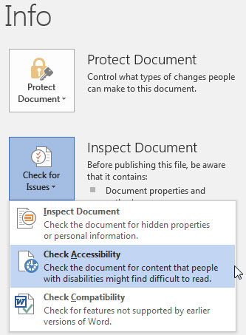
Microsoft Office Accessibility Checker
Use the built-in accessibility checker in
Microsoft Excel
Microsoft PowerPoint
Microsoft Word
The checker is not available in Microsoft Publisher

Slide 32
Microsoft Office Application Notes
Microsoft Excel
All worksheets should have unique names
All blank worksheets should be removed
Microsoft PowerPoint
All slides should have unique titles
Check the reading order of each slide using the “Selection” pane found under the “Select” option on the Home ribbon
Microsoft Publisher
Publisher is designed for PRINT. Some accessibility features are not available.

Slide 33
Google Docs
Google Docs currently only has the following accessibility features
Setting Alternative Text for images
Using headers for structure
If you need to share a Google Doc accessibly, you should
Download it as a Microsoft Word document
Run the accessibility checker and fix any errors
Either share the Word document OR
Convert it to a PDF and check accessibility in Acrobat Pro
It is not recommended to download the Doc directly to PDF.
Add-On: Grackle Docs (checker free, tagged PDFs $$)

Slide 34
Accessibility in Adobe InDesign

Slide 35
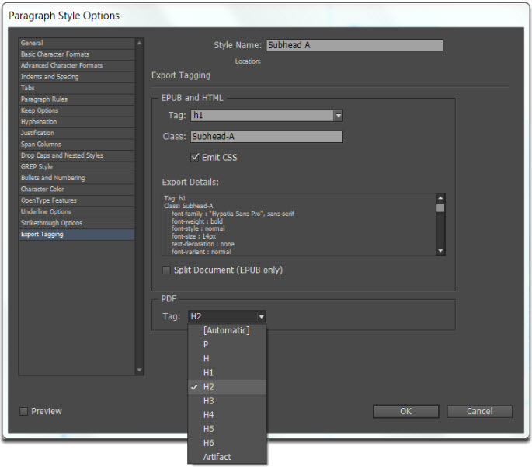
Mapping Styles in InDesign
Paragraph and Character Style Options > Export Tagging
OR
“Edit All Export Tags…” in the flyout menu for Paragraph Styles and Character Styles

Slide 36
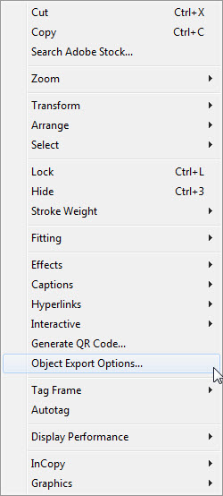
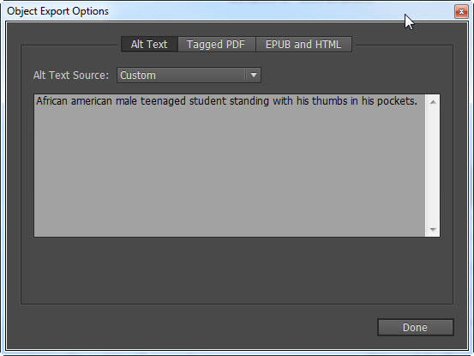
Alternative Text in InDesign
Right-click any object and choose “Object Export Options”
Change source to “Custom” and enter text in the box

Slide 37
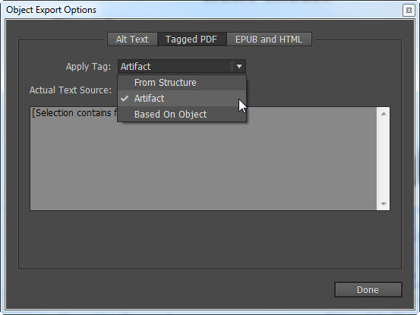
Artifacts in InDesign
In Object Export Options, change to the “Tagged PDF” tab
Change the “Apply Tag” dropdown to “Artifact”
Artifacts are decorative objects that do not add context to the document and are ignored by screen readers and do not require alternative text

Slide 38
Establishing Reading Order in InDesign
Use the Articles panel to establish reading order
Select each object on the page and drag them on to the Articles panel in the natural reading order of the document
Objects can be re-ordered in the Articles panel if necessary
There is an option to add all selected content to an article

Slide 39
Using Adobe Acrobat Professional DC with Accessible Documents

Slide 40
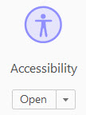
Acrobat Accessibility Tools
First, run a “Full Check” on the document

Slide 41
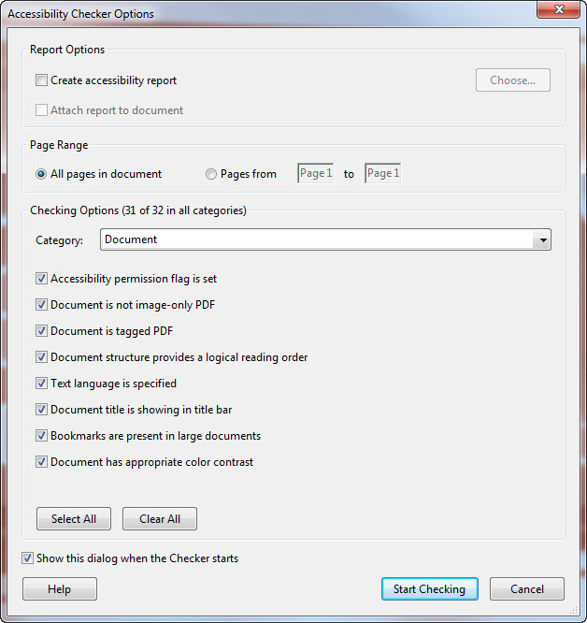
Accessibility Checker Options
Uncheck “Create accessibility report”
Click “Start Checking”

Slide 42
Navigating the Sidebar
Bookmarks ►
Accessibility Checker ►
Content ►
Reading Order ►
Tags ►

Slide 43
Full Check Results
A new sidebar is shown on the left side of the screen
Accessibility problems are categorized
Use the + and – buttons to navigate the list and see errors that need to be fixed

Slide 44
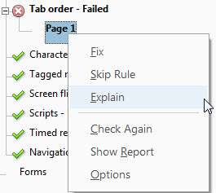
Explain and Check Again
Right-clicking on any item in the checker will show an option called “Explain”
This option will open the Adobe Help page in your browser and skip to the relevant section with step-by-step guidance.
Click “Check Again” if you’ve made changes and want to see if the error was resolved.

Slide 45
Items Requiring Manual Check
Two items will always need a manual check
Reading Order
Scroll through the Content and Tags panels. Content can be dragged-and-dropped to correct order problems.
Color Contrast
Black and white is highest contrast possible
Once you’ve manually checked these, you can right-click on them and choose “Pass”

Slide 46
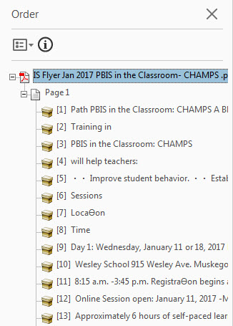
Reading Order Panel
Where possible, items on the reading order panel should match the natural flow of the document
Items can be dragged-and-dropped to fix the order
Only the built-in Adobe screen reader uses the order from the Reading Order panel
Screen readers use the order in the Content and Tags panels, NOT the Reading Order panel

Slide 47
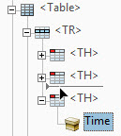
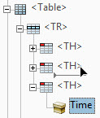
Reordering Items in the Content and Tags Panels
Pay very close attention when dragging and dropping items
The first picture below will move the text element between the two TH elements, as a child of the TR element
The second picture below will move the text element to be a child object in the TH element

Slide 48
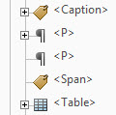
Removing Empty Content & Tags
After marking appropriate content as Artifacts, you may end up with “empty” content containers and tags
Once you verify that the contain no content, you should delete them
Occurs frequently if you use unnecessary “returns”

Slide 49
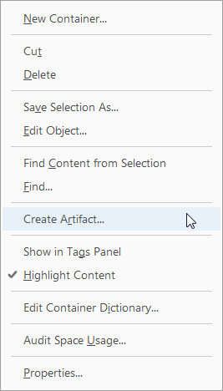
Marking Content as Artifacts
Artifacts are content that is decorative or do not add any context to the document
Right-click on any object in the Content pane and choose “Create Artifact” (The default options are OK.)
The selected content and its children will be added to a new Artifact container in the same location in the tree
Multiple Artifact containers in the same location are automatically combined
To undo, right click on the new Artifact and choose “Remove Artifact.” The content will reappear in the same location without the Artifact container

Slide 50
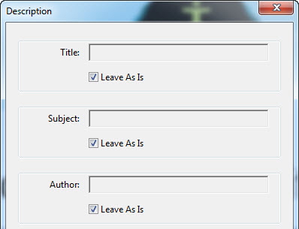
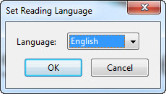
Simple Fixes
Some errors may be easy to fix
Right-click on each error and choose “Fix” where possible
Primary Language
Title

Slide 51
Types of Tags
Containers
Headings and paragraphs
Labels and lists
Special Text
Tables
In-line
Special in-line
Artifacts: Items that are decorative in nature and should not be read or interpreted by a screen reader.

Slide 52
Container Tags
Document (root)
Part
Large division. May group smaller units together.
Div
Division
Art
Article. Self-contained body of text considered to be a single narrative.
Sect
Section. General container.

Slide 53
Heading and Paragraph Tags
P
Paragraphs
H
Headings
Levels 1-6 (H1, H2, H3, H4, H5, H6)
A heading should start each section
Don’t skip heading levels

Slide 54
Label and List Tags
L
Lists
Wraps around entire list
LI
List items inside a list
LBL
Labels
A bullet, name, or number that identifies and distinguishes an element from others in the same list
Lbody
List item body element
The descriptive content of a list item

Slide 55
Special Text Tags
BlockQuote
One or more paragraphs or text attributed to someone other than the author of the surrounding text.
Caption
A brief portion of text that describes a table or figure.
Index
Listing of occurrences in text in the main body of the document.
TOC
Table of Contents – Wraps around entire TOC
TOCI
Table of Contents item element

Slide 56
Table Tags
Table
Wraps around entire table
TR
Table Row
TD
Table Data Cell
TH
Table Header Cell
Can be Columns or Rows
Set on each cell

Slide 57
In-line Tags
BibEntry
Bibliography entry
Quote
In-line portion of text attributed to someone other than the author of surrounding text
Span
An in-line segment of text
Usually sets text apart that has different styling

Slide 58
Special In-line Tags
Code
Computer program text
Figure
A graphic or graphic representation associated with text
Form
Form field that accepts input
Formula
A mathematical formula
Link
Hyperlink
Note
Explanatory text such as a footnote or endnote
Reference
Citation to text or data found elsewhere in the document

Slide 59
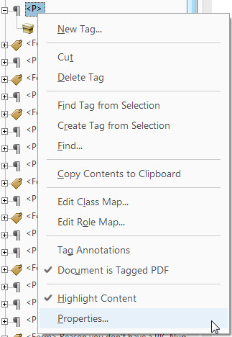
Changing Tags
Right-click on any tag in the Tags pane and choose “Properties”
Here, you can change the tag type
Example
Change Paragraph (P) to Heading (H)

Slide 60
Layered Items in the Content Panel
When re-ordering items in the Content panel, sometimes items may disappear
Make sure backgrounds appear “above” foreground content

Slide 61
Adding Bookmarks
For larger documents, bookmarks offer a great way to navigate the document for all users
Once your headings are set in the Content and Tags panel, go to the Bookmarks panel and choose “New Bookmarks from Structure…”
Choose the appropriate heading level to use as bookmarks
Acrobat will add a bookmark for each element of that type in the document

Slide 62
Forms & Tooltips
Add form fields after rest of document has passed accessibility checker
Every field must have a unique name
Add alternative text in the “Prepare Form” section by right-clicking each field in the sidebar, going to Properties, and entering it as the Tooltip

Slide 63
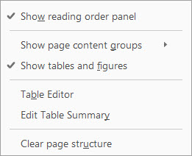
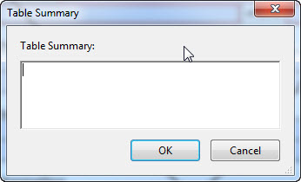
Set Table Summaries
Every data table must have a summary
Change to Reading Order mode and right-click on any table
Choose “Edit Table Summary”

Slide 64
Non-Data/Layout Tables
Acrobat Pro does not have a way to indicate a table is used only for layout
All content inside the <table> tags must be moved (selected-and-dragged) out of the individual <td> tags and then delete the entire <table> tag

Slide 65
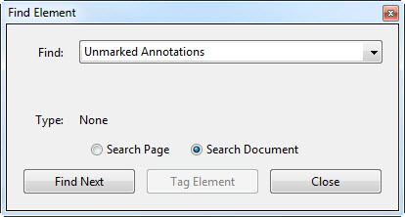
Tagging Forms
Acrobat does not automatically tag form fields
On the Tags pane, use the “Find” option to find “Unmarked Annotations”
Tag each form field as a Form type and add an informative Title to each field

Slide 66
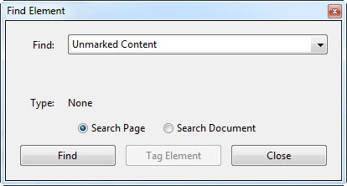
Tagging Unmarked Content
Make sure appropriate items are marked as Artifacts (this solves a lot of these errors)
On the Tags pane, right-click to use the “Find” option to find “Unmarked Content”
Click “Find Next” and click “Tag Element” to tag the element
Change the Tag if necessary and add a short description

Slide 67
Citations & Copyright
Citations
NCDAE - ncdae.org/resources/factsheets/principles.php
WebAIM - webaim.org/techniques/alttext/
Screenshots from Microsoft Office and Adobe Acrobat Professional DC
Created By:
Joel Selby Special Projects Manager Muskegon Area Intermediate School District jselby@muskegonisd.org (231) 767-7227
This document is licensed by Joel Selby under the Creative Commons Attribution Noncommercial 3.0 United States License. You can copy, share, and adapt this presentation without the need to contact me for permission, as long as you give proper credit and don’t charge for it.

