Slide 1
MEAP 3rd Grade Reading
Percentage of increase in % Proficient 2008-09 to 2013-14
5 year % increase in Proficient students

Slide 2
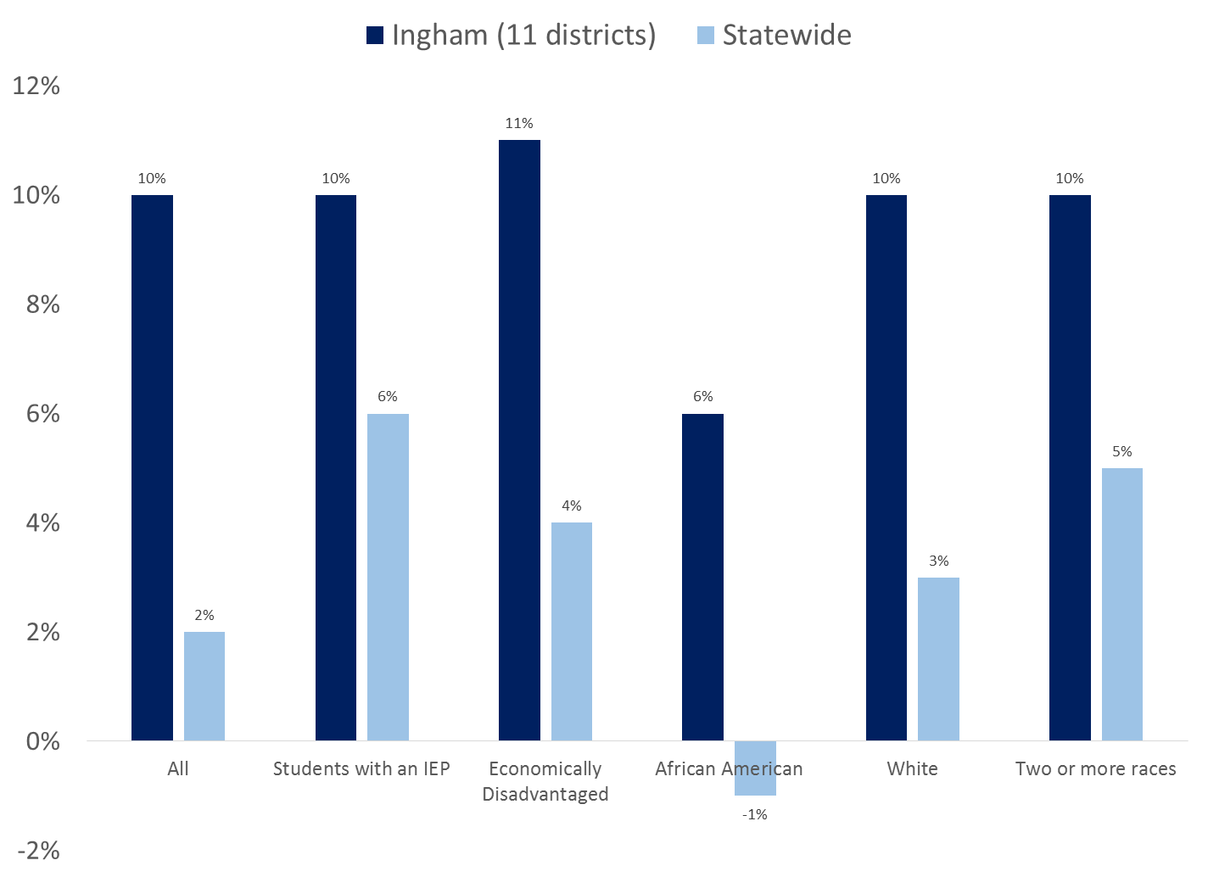
MEAP 3rd Grade Reading
Difference in the Percent Proficient from 2008-09 to 2013-14

Slide 3
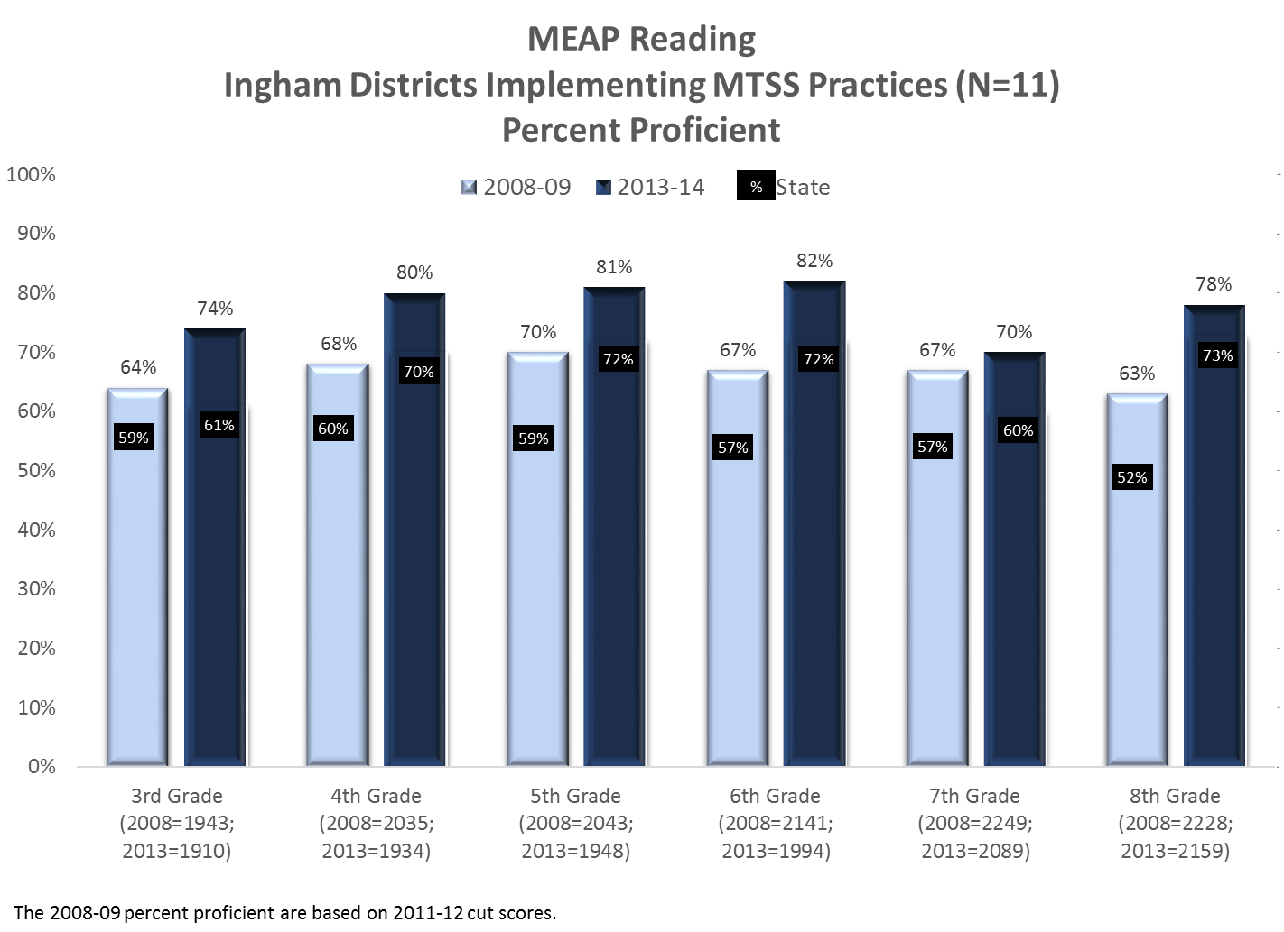

Slide 4
